Slide 1
Evangelism Toolbox
Tim Turner - WVCSB
Purpose: An overview of the importance of evangelism and methods in West Virginia.

Slide 2
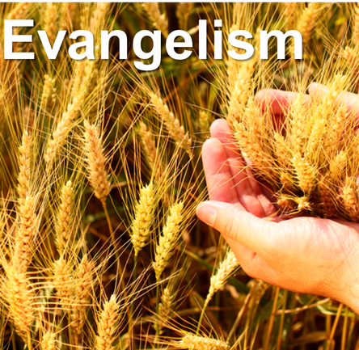
If someone was to ask you why one should be so concerned about evangelism as a Christian, how would you answer that question?
Through Conversations

Slide 3
Common Answer #1:
I should love everyone, but not sure why.
Common Answer #2:
Jesus loves them, so I should also?

Slide 4
Common Answer #3:
If I don’t, then I will feel guilty.
Common Answer #4:
I don’t want anyone to spend eternity in Hell.

Slide 5
Common Answer #5:
Jesus commanded the Apostles and ultimately the Church to do so.
(Matthew 28:19-20, Acts 1:8)

Slide 6
If Scripture is true, and it is, why do so few believers share Christ in any form or fashion.
The Billy Graham Evangelistic Association (2018),
“Research has shown that 79% of unchurched people would engage in a faith conversation if asked. That’s the good news. But here’s the bad news: only 39% of Christians have shared how to become a Christian with someone in the past six months.”

Slide 7
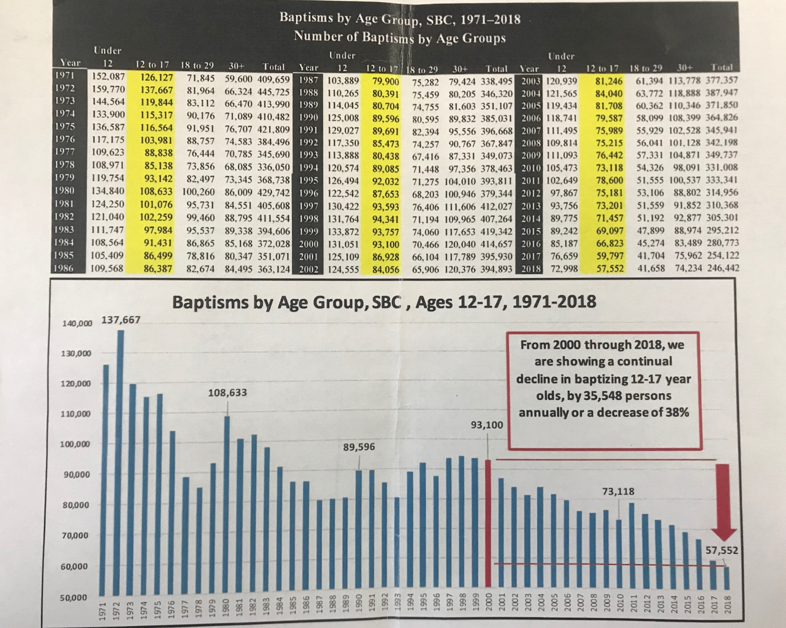
.
Baptisms by Age Group, SBC, 1971-2018

Slide 8
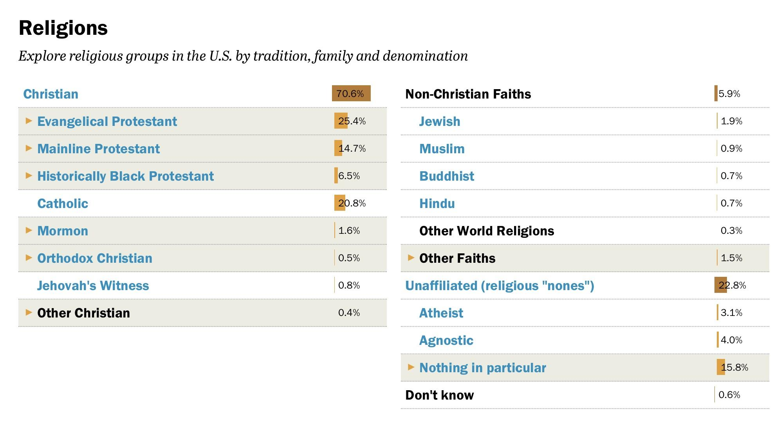
.
Religious Landscape Study, Adults in USA

Slide 9
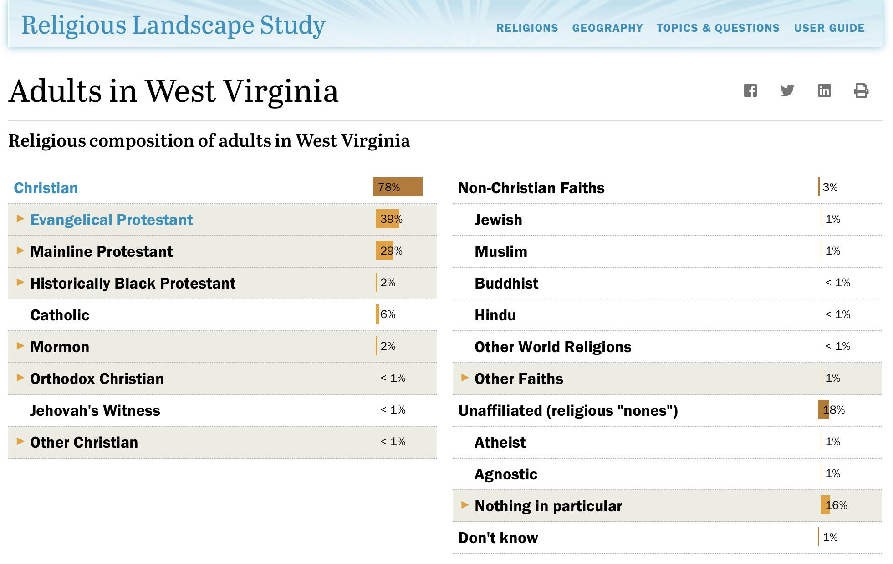
.
Religious Landscape Study, Adults in WV

Slide 10
Cause for Concern?
Transformational Discipleship Study (2011):
(28) experts in discipleship surveyed
(1,000) Protestant pastors surveyed
(4,000) Protestant church(goers) surveyed
41% do not attend small classes or small groups from their churches.
42% intentionally spend time with other believers in order to grow in faith.
54% say they set aside time daily for private worship, praise, or thanksgiving to God (prayer not included)
25% say they have shared their faith once/twice in last six months.
19% read the Bible everyday.

Slide 11
Cause for Concern?
This research revealed eight (8) attributes of growing believers:
Bible engagement
Obeying God, denying self
Serving God and others
Sharing Christ
Exercising faith
Seeking God
Building relationships
Unashamed (transparency)

Slide 12
¹⁹ Go, therefore, and make disciples of all nations, baptizing them in the name of the Father and of the Son and of the Holy Spirit, ²⁰ teaching them to observe everything I have commanded you. And remember, I am with you always, to the end of the age (Matt. 28:19-20 CSB)

Slide 13
Believers tend to think these words were given to the 12, therefore, . . .
Only for the original 12, who in turn made disciples, and the Gospel can be heard throughout, therefore, we are exempt.
Only for those who are vocationally called such as a youth pastor, pastor, or missions’ pastor.
Only for missionaries because they are the ones who are evangelizing the “world” and don’t consider communities a mission field.
Or just scared to death to be a witness for Christ.

Slide 14
Look briefly at the Great Commission in Matt. 28:19-20:
“Go” – Gk. means literally to “traverse or take a trip or to go forth”. As a continual verb it is translated “as you are going”.
“teach” – Gk. means to “make a disciple out of” and not just to gain knowledge.
“all nations” – or “all forms of declension” – (Gk. ethnos) is “a nation or people, the entirety of mankind” Therefore, it connotes ALL forms and the whole of mankind. This definition helps us to see the importance of the Imago Dei or the whole creation of man as precious to God the Creator.

Slide 15
Look briefly at the Great Commission in Matt. 28:19-20:
“baptizing” (Gk. baptizo) – to immerse or submerged for the public demonstration of faith in Christ alone.
“teaching” – (Gk. didasko) – process of teaching someone for the purpose of learning what it means to be a Christian.
“observe” – to keep watch while learning.
“command” – to give a charge. Christ did this while on earth in the flesh to all of which He came in contact.

Slide 16
APPLICATION: How do we expect others to follow us?
An old Chinese Proverb says, “Give a man a fish, feed him for a day. Teach a man to fish, feed him for a lifetime.”
Jesus did just that when he called Peter to discipleship when he called him, “And He said to them, ‘Follow Me, and I will make you fishers of men.’” (Matt. 4:19 NASB)

Slide 17
“But you will receive power when the Holy Spirit has come on you, and you will be my witnesses in Jerusalem, in all Judea and Samaria, and to the ends of the earth.” (ACTS 1:8)

Slide 18
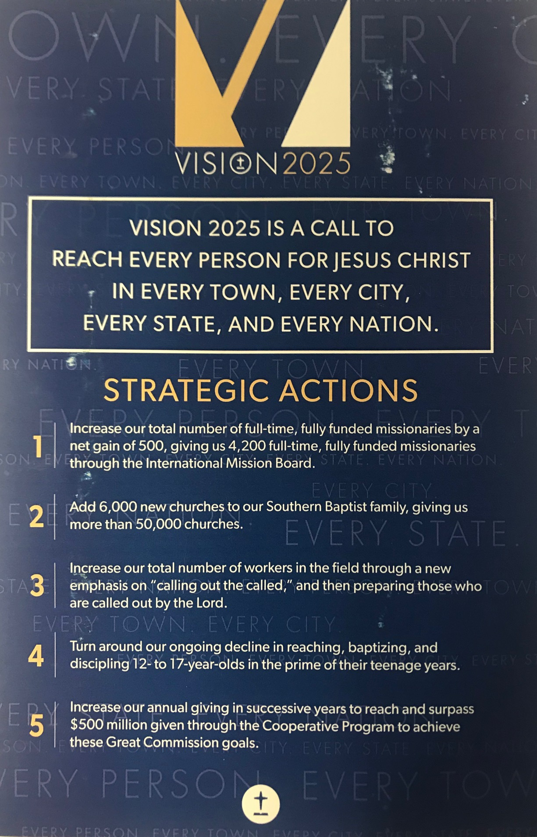
VISION 2025
SBC EVANGELISM
LAUNCHED IN 2020

Slide 19

“In asking Christians about their witnessing activities, we have found that 9 out of 10 who attempt to explain their beliefs and theology to other people come away from those experiences feeling as if they had failed . . . they perceive themselves as failures.”
(Christian Researcher)
Why Do You Think This Fact is True?

Slide 20
F.A.I.T.H. Evangelism Strategy
In the mid 1990’s, Bobby Welch, pastor of FBC Daytona Beach had a vision for an evangelism strategy that was based in the Sunday School ministry of the church. That vision birthed a tool that was popular for 15 years.

Slide 21


The Beginning - Step One
A (3) person Team
Think Conversationally
Look for Opportunities
Be open-minded

Slide 22
Step Two:
Search for common areas of interest
Ask questions
Listen for spiritual markers
Discover details about church background
Let the person speak
Ask for clarification

Slide 23
Step Three:
Sunday School/Small Group Testimony
Support and friendships
Help in times of need
Learning and applying God’s Word in life
Growing as a Christian
Opportunity to make a difference in someone else’s life

Slide 24
Step Four:
Evangelistic Testimony (1-2 mins)
Pre-conversion experience – What life was like before Christ without details of sins, etc.
Conversion experience – How Christ revealed himself to you and you surrendered to him.
Recent benefits of your conversion – Reflect on God’s forgiveness, changes in your life, and a statement of God’s assurance.

Slide 25
Step Five:
THE KEY QUESTION --
In your personal opinion, what does it take for a person to go to heaven?
A Faith Answer
A Works Answer
An unclear Answer
No opinion

Slide 26
Step Six:
Transition in the FAITH Presentation
“If it is okay, I’d like to share with you what the Bible says about this question I just asked you?”
Yes.
No.
Maybe later.
I’m not sure

Slide 27
Spell the word F.A.I.T.H. out on your hand:
First, F is for forgiveness.
Everyone has sinned and needs forgiveness
“For all have sinned and fall short of the glory of God.” (Rom. 3:23)
That can only be found in Christ.
“In Him (meaning Jesus) few have redemption through His blood, the forgiveness of our trespasses, according to His riches of His grace.” (Eph. 1:7)

Slide 28
Spell the word F.A.I.T.H. out on your hand:
A is for Available.
God’s forgiveness is available for all.
“God so loved the world in this way; He gave His one and only Son, so that everyone who believes in Him will not perish but have eternal life.” (John 3:16)
But God’s love is not automatic.
“Not everyone who says to me, ‘Lord, Lord!’, will enter the kingdom of heaven.” (Matt. 7:21)

Slide 29
Spell the word F.A.I.T.H. out on your hand:
I is for Impossible.
According to the Bible, it is impossible for someone to get to heaven on their own.
“By grace you are saved through faith, and this is not of yourselves; it is God’s gift – not or works so that no one can boast.” (Eph. 2:8-9)
Key: Most people you talk to think they are pretty good people and by the world’s standard that is probably true.
Transition: “So how then can a sinful person receive eternal life and enter heaven?”

Slide 30
Spell the word F.A.I.T.H. out on your hand:
T is for Turn
If you were going down a road and someone asked you to turn, what are they asking you to do?
CHANGE DIRECTION FROM YOUR CURRENT COURSE.
Turn means to Repent. Turn from Sin and self 180 degrees.
“Unless you repent, you will all likewise perish.” (Luke 13:3)

Slide 31
Spell the word F.A.I.T.H. out on your hand:
T is for Turn
Turn to Jesus alone as your Lord and Savior.
“I am the way, the truth, and the life. No on comes to the Father except through me.” (John 14:6)
Here is the greatest news of all.
“If you confess with your mouth, ‘Jesus is Lord,’ and believe in your heart that God raised Him from the dead, you will be saved. With the heart one believes, resulting in righteousness, and with the mouth one confesses, resulting in salvation.” (Rom. 10:9-10)
Transition: What happens if a person is willing to repent of their sins and confess Christ?

Slide 32
Spell the word F.A.I.T.H. out on your hand:
H is for Heaven
Heaven is a real place (no mythical) where we will live with God forever.
“If I go to prepare a place for you , I will come back and receive you to Myself, so that where I am you may be also.” (John 14:3)
Eternal life begins NOW with Jesus.
“I have come that you may have life and have it in abundance. (overflowing).” (John 10:10)
H can also stand for how. How can a person have God’s forgiveness, eternal life, and heaven? By trusting Jesus as your Savior and Lord.
Tim’s note: Use this last question as open-ended so that the person might ask more questions as they consider the Gospel presentation.

Slide 33
Spell the word F.A.I.T.H. out on your hand:
H is for Heaven
Heaven is a real place (no mythical) where we will live with God forever.
“If I go to prepare a place for you , I will come back and receive you to Myself, so that where I am you may be also.” (John 14:3)
Eternal life begins NOW with Jesus.
“I have come that you may have life and have it in abundance. (overflowing).” (John 10:10)
H can also stand for how. How can a person have God’s forgiveness, eternal life, and heaven? By trusting Jesus as your Savior and Lord.
Tim’s note: Use this last question as open-ended so that the person might ask more questions as they consider the Gospel presentation.

Slide 34
Step Seven:
Invitation
INQUIRE: “Understanding what has just been shared, would you like to receive forgiveness by trusting Christ in Christ as your personal Lord and Savior?”
INVITE
INSURE

Slide 35



Slide 36
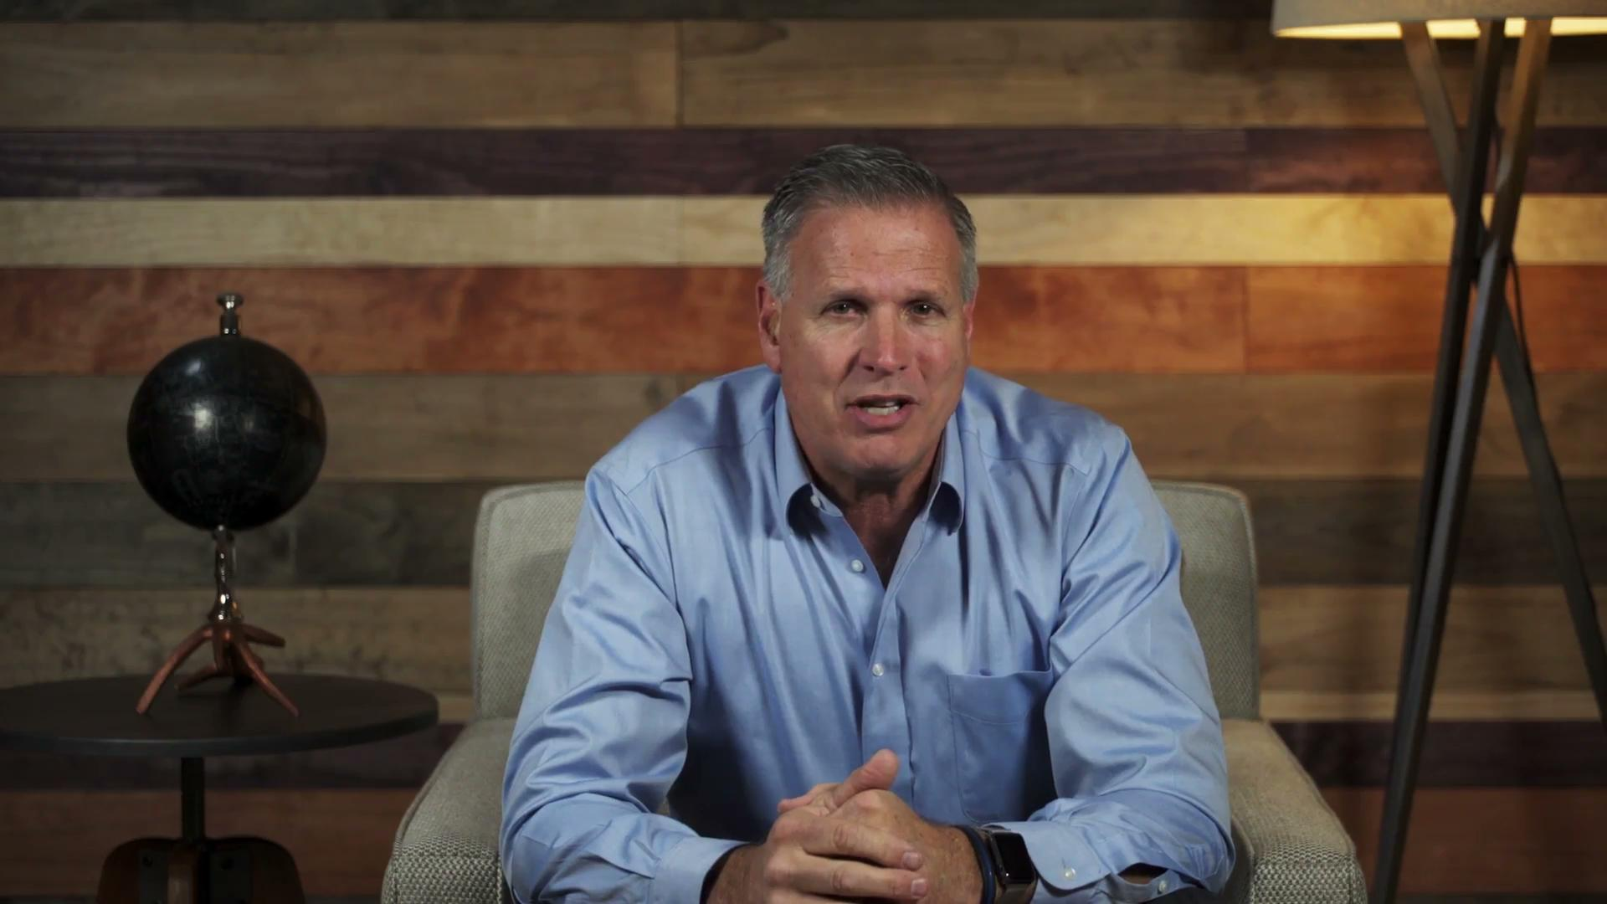

Slide 37

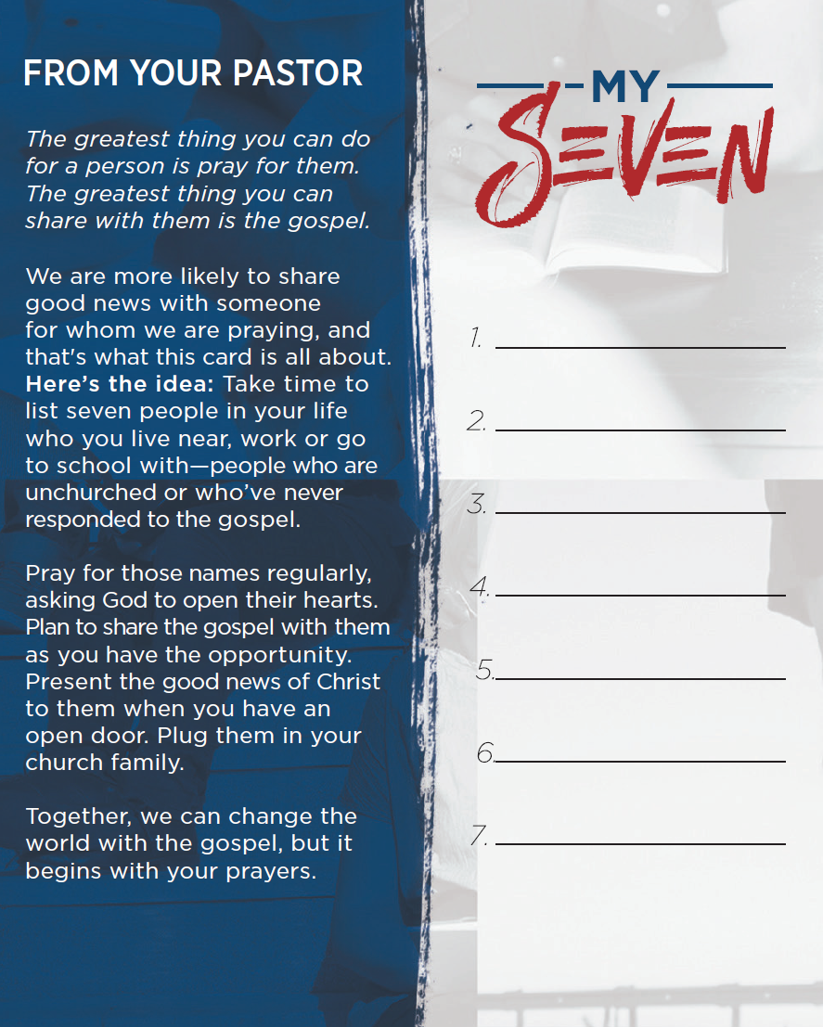

Slide 38
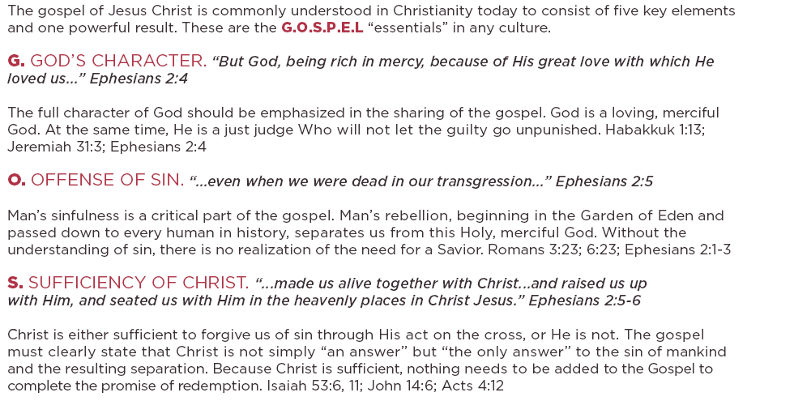

Slide 39
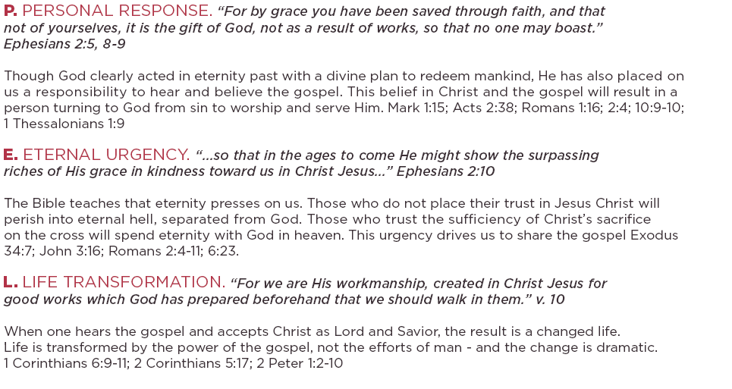

Slide 40

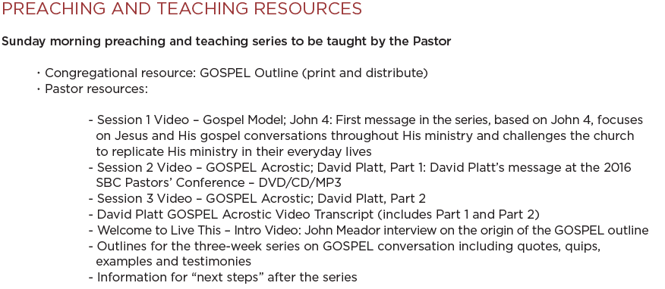

Slide 41
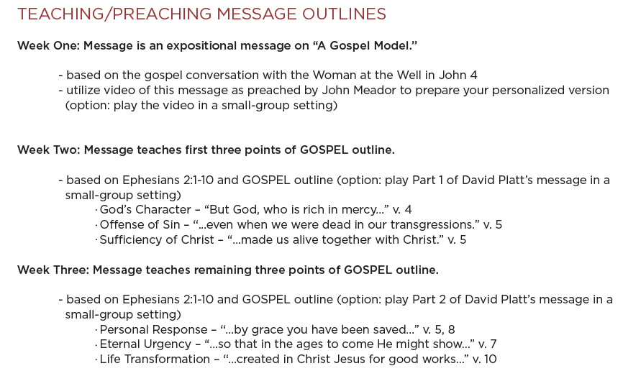

Slide 42
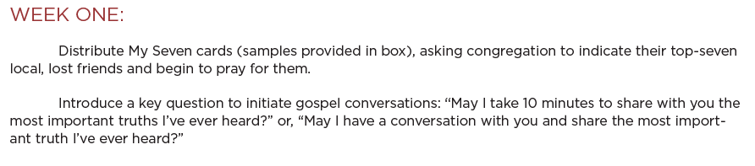

Slide 43
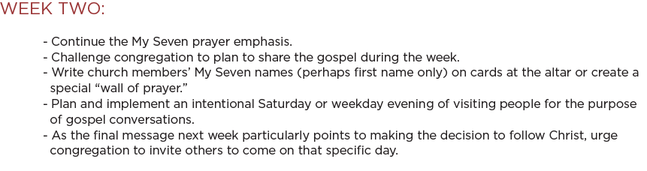

Slide 44
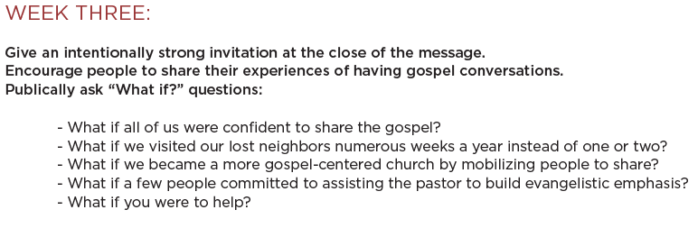

Slide 45
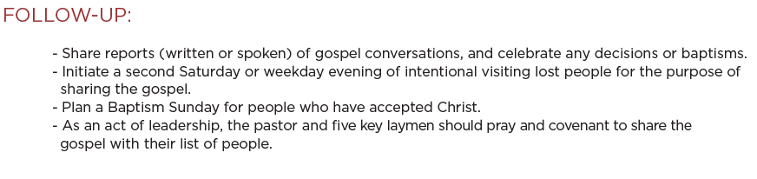

Slide 46


Slide 47

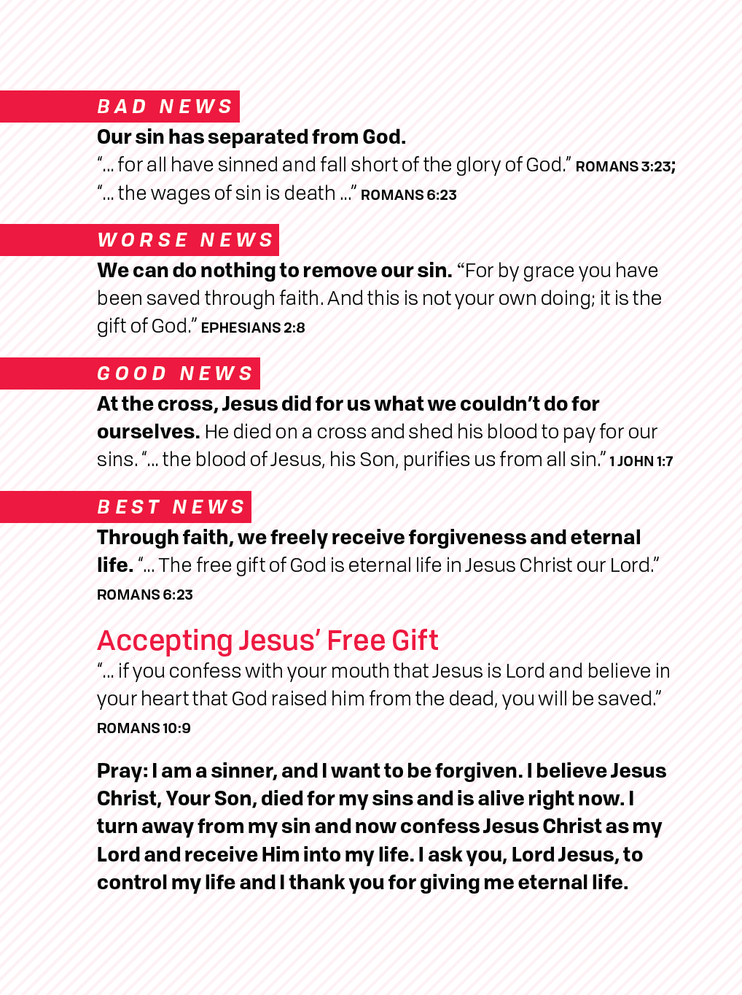

Slide 48
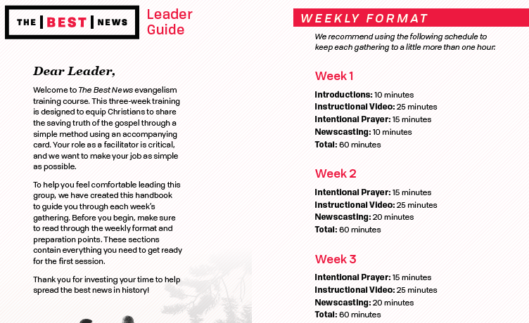

Slide 49
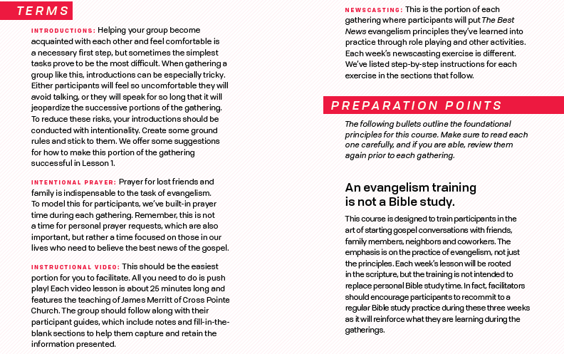

Slide 50
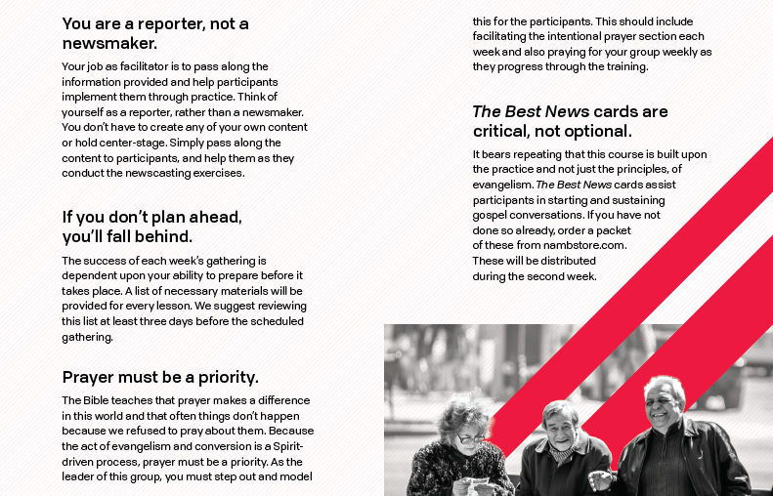

Slide 51
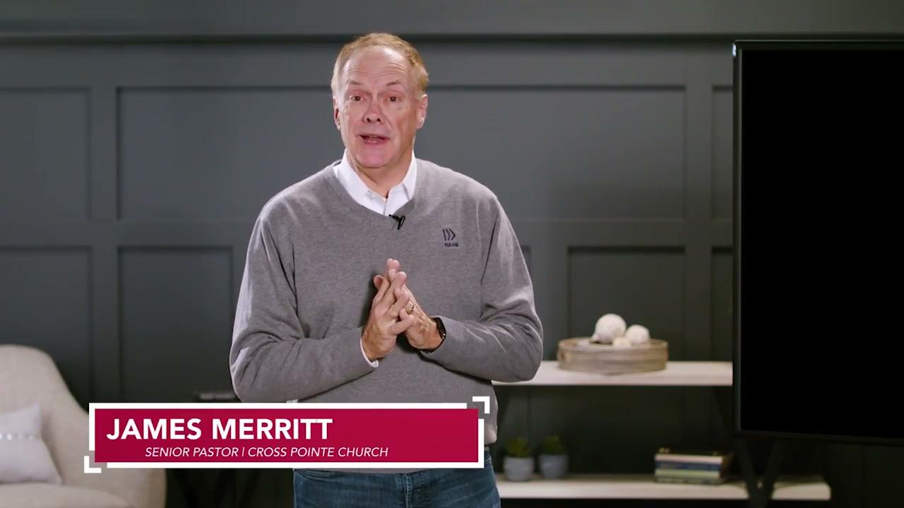

Slide 52
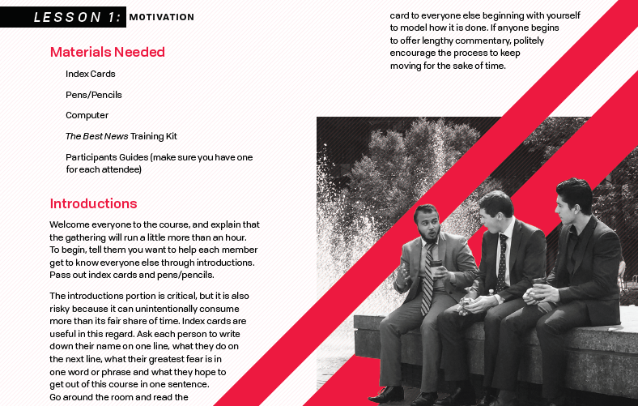

Slide 53
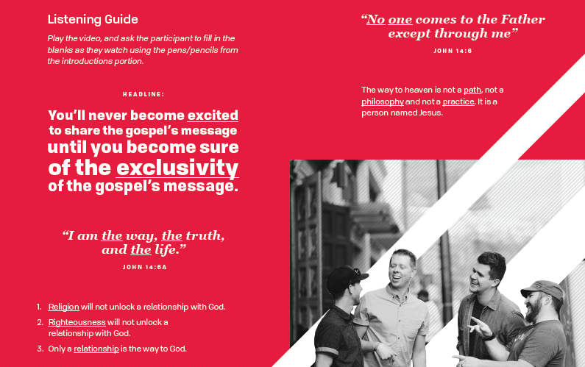

Slide 54
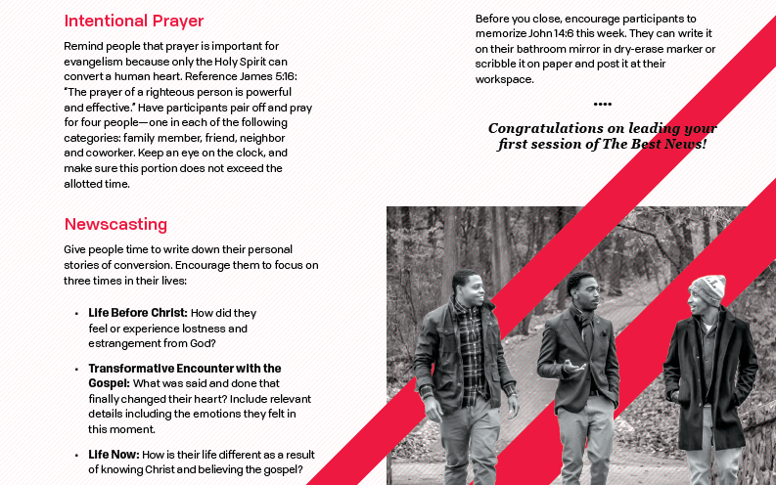

Slide 55
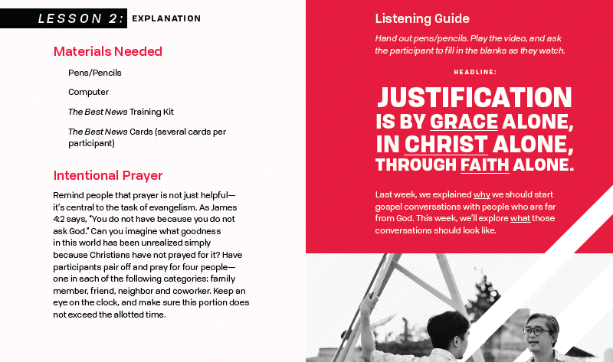

Slide 56
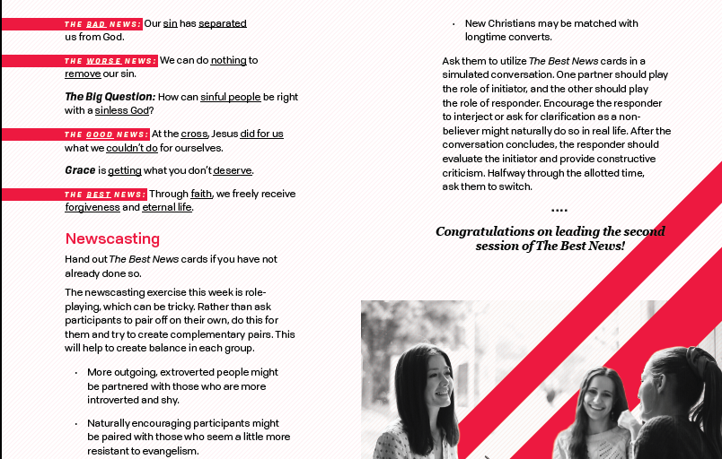

Slide 57
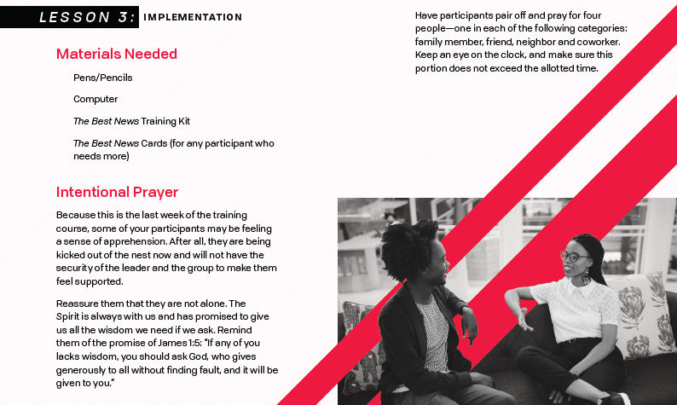

Slide 58
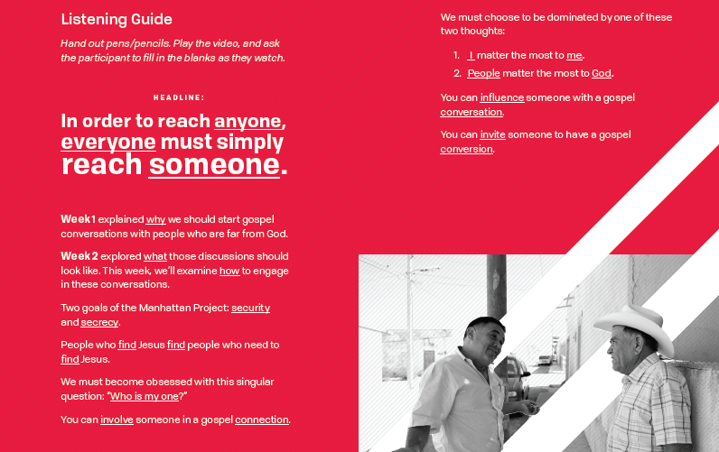

Slide 59
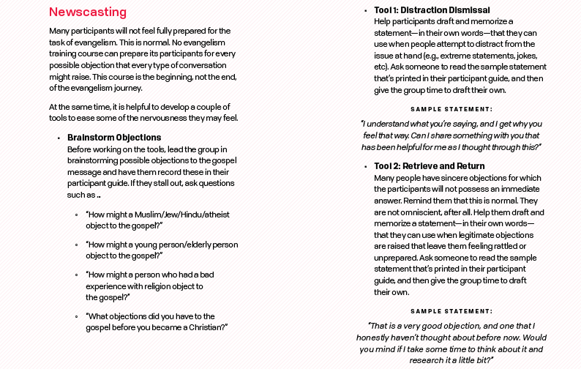

Slide 60




Slide 61

Purpose of the 3-Circles Training
To help your people realize that anyone can share the story of Christ through Gospel conversations.
In your ministry setting, what is the most difficult aspect of helping your people with learning to share the Gospel with others?

Slide 62
Strategy of church to train their people:
Air War: Lead Pastor executes the air war casting vision in 3-week sermon series:
Model the 3-Circles Life Conversation guide each week.
Cast vision for the lostness of the community in which you live
Remind people of the mission Jesus gave His followers
Rally people for the upcoming training.

Slide 63
Strategy of church to train their people:
Ground War: 6-weeks training that starts the week after the conclusion of the series
(6) Training videos
(6)-session Trainer guides
Turning Everyday Conversations into Gospel Conversations book.
3-Circles Wristband

Slide 64


Slide 65

Genesis 1:31
Psalm 139
John 1:3

Slide 66

Genesis 3
Romans 3:23
Romans 6:23

Slide 67

Romans 1:25
Proverbs 14:12

Slide 68
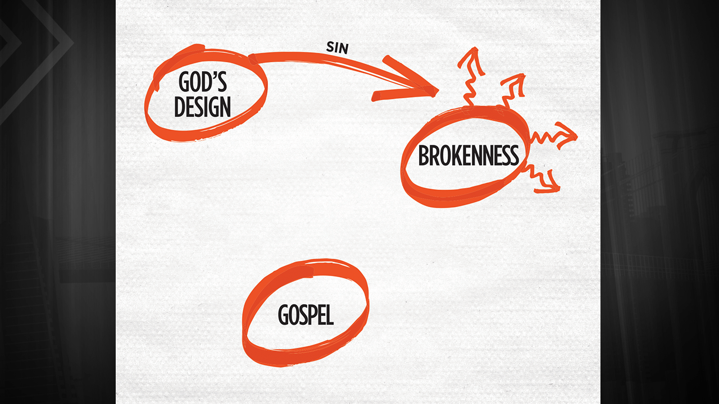
John 3:16
Col. 2:14
Romans 5:8

Slide 69
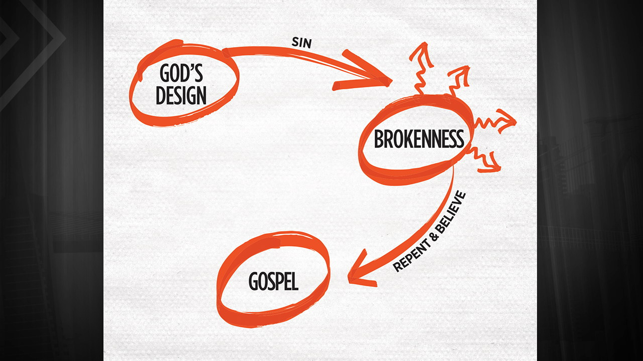
Eph. 2:8-10
Romans 10:9

Slide 70
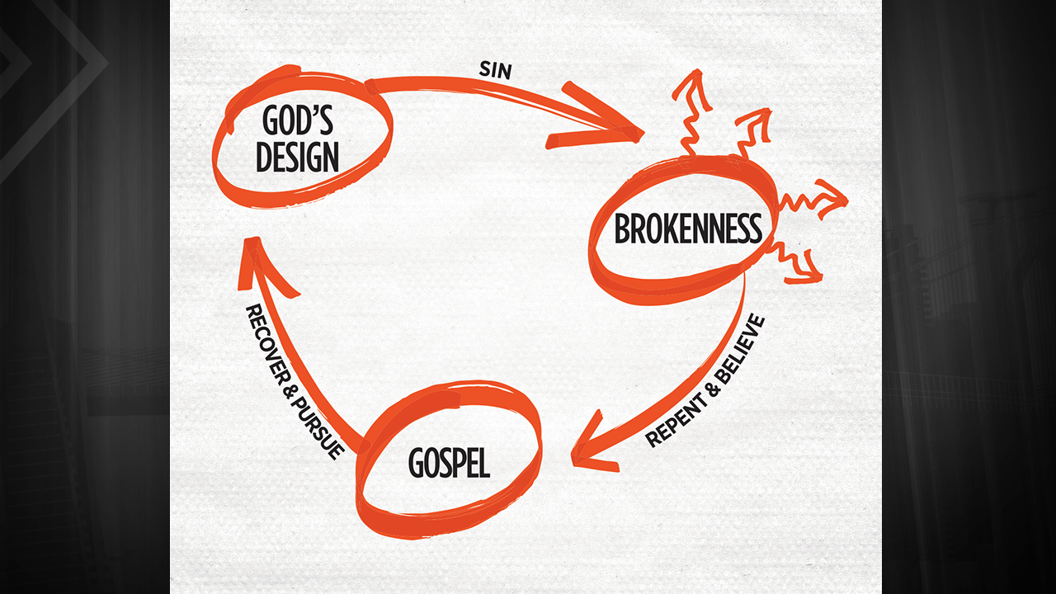
Phil. 2:13
Eph. 2:10

Slide 71
Strategy of church to train their people:
Additional Air Strategies:
Sermon bumper video
Prayer and Gospel Conversations
Student Camp/Retreat
Kids Camp
Leadership Training events
Celebrate victories

Slide 72

God‘s Design -- Genesis 1-2
Brokenness -- Genesis 3:1-19
The Gospel -- Genesis 3:15; John 3; I Cor. 15:1-4; 2 Cor. 5:17-21

Slide 73
Training Kit Overview:
Preach the Sermons (3 weeks)
Train your people (6 weeks)
Practice (daily challenge)
Watch what God will do.

Slide 74
Closing thoughts – Q & A
What might have been stirred in your heart today about evangelism practices?
What might be your next steps to helping your church advance the Gospel though evangelism training?
QUESTIONS
Thanks for allowing us to serve you today.

